Slide 1
529 Advance Data Analytics Mid-term Project
Occupancy Detection Analysis
Allen Dsouza
A20349741

Slide 2
Table of Content
Business Scenario and Objective
Questions
Dataset Overview
Identifying Variables
Exploratory Data Analysis Results
Regression Modeling Results
Summary/Conclusions

Slide 3
Business Scenario
Business Scenario
In a particular organization, some unknown personnel accessed restricted areas of the building and stole important data. The surveillance cameras failed to capture these details because it was hacked into. The company doesn’t want to risk losing sensitive data to competitors or any espionage agency in the future. The organization, now knowing that it cannot just rely on one security system wants to build a system that will detect the occupancy of a room with the help of ambient factors. Sensors were placed to record these ambient factors :- Light, CO2, Humidity, Temperature and Humidity Ratio.

Slide 4
Business Objective
Business Objective
The objective is to build a model which identifies the most influential ambient conditions (Temperature, Light, CO2, Humidity, Humidity Ratio) that can accurately determine the Occupancy status of a room. Using this model the organization can then successfully determine if a room is occupied or no.
Below are some business questions that we will answer through our analysis
1. What are the maximum and minimum values of Temperature, Light, CO2, Humidity, Humidity Ratio recorded by the sensors when the room was occupied and when not occupied.
2. What is the relationship between Occupancy and each of its predictor variables :-
(Temperature, Light, CO2, Humidity, Humidity Ratio )
3. Which of the above predictor variables will have the most influence in determining the occupancy status of a room compared to the other predictor variables.
4. What are the ideal predictor variable values that can determine the occupancy status.
5. What is the probability of a room being Occupied given a set of predictor variables: - Temperature, Light, CO2, Humidity, Humidity Ratio

Slide 5
Dataset Overview
Source of Data: https://archive.ics.uci.edu/ml/machine-learning-databases/00357/
Total No of Rows: 20560
Total No of Variables: 7
Time Period: 2 -Feb 2015 – 18 Feb 2015 generated every minute.
Variable | Type | Description
Occupancy | Categorical | Occupancy status of the room
Date | Categorical | Date in format year-month-day hour: minute: second
Temperature | Continuous | Temperature, in Celsius
Light | Continuous | Light, in Lux
Humidity | Continuous | Relative Humidity %
CO2 | Continuous | CO2 in ppm
Humidity Ratio | Continuous | Derived quantity from temperature and relative humidity, in kgwater-vapor/kg-air

Slide 6
Identifying Dependent and Predictor Variables
1. Dependent Variable(Y): Occupancy is the dependent variable.
Y= 1 if room is occupied
Y= 0 if room is not occupied
2. Predictor Variable(X): Temperature, Light, Humidity, CO2, Humidity Ratio are predictor variables which are also ambient features that influence the occupancy status of the room.

Slide 7
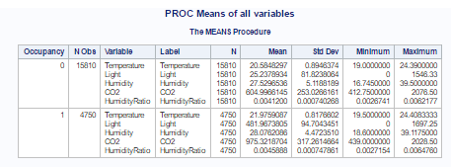
Exploratory Analysis – 1) Descriptive Statistics
In this section , we explore the data by analyzing Descriptive Statistics
Proc Means helps us explore our dataset to determine if its complete and free from any missing values. It also helps us answer the 1st questions of our analysis.
What are the maximum and minimum values of Temperature, Light, CO2, Humidity, Humidity Ratio recorded by the sensors when the room was occupied and when not occupied ?

Slide 8
Exploratory Analysis – 2)Association
Pr > F
In this section , we explore the data by analyzing Associations between Occupancy (Y) and its Continuous predictors (X’s) – Temperature. Light, CO2, Humidity, Humidity ratio
Statistical techniques such as the T-test can be used to determine if there is any association between the response variable Occupancy and its predictor variables. The T-test (equality of variance test) will help to determine whether an occupied room provides a different mean for predictor ambient variables than for an unoccupied one.
2. In T-test, we check the Equality of Variance table for the F-value and its P-value.
When the p-value (shown under "Pr>F") is no more than 0.05, then the variances are unequal
When the p-value (shown under "Pr>F") is greater than 0.05, then the variances are equal.
Results
The T-test determines which Continuous predictors (X’s) are associated with Occupancy and which are not. The list of possible predictors are listed in Slide No 11.

Slide 9
Exploratory Analysis – 2)Association
Out of 5 possible continuous predictor variables, only 3 qualified the T-test which have Pr >F less than 0.05.
Results
From the above statistical analysis, we confirm that Light, CO2 and Humidity Ratio show a significant difference in variance . In other words an occupied room provides different means for Light, CO2 and Humidity Ratio than for an unoccupied one. Thus we can say they show association with Occupancy.
2. Temperature and Humidity show equal variances and therefore indicate lack of association.
Variable | F – value | Pr >F | T value | Include in the Model?
Temperature | 1.04 | 0.7482 | -15.44 | No
Light | 1.34 | < . 0001 | -324.85 | Yes
Humidity | 1.06 | 0.7075 | 598 | No
CO2 | 1.57 | < . 0001 | -83.13 | Yes
Humidity Ratio | 1.29 | < . 0001 | -8.78 | Yes

Slide 10
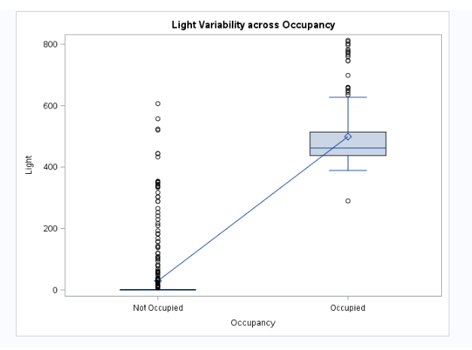
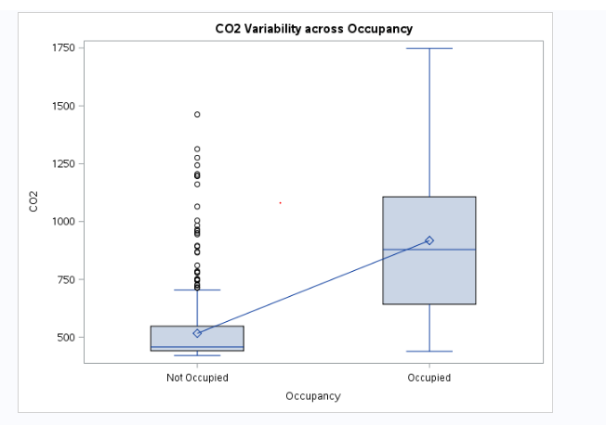
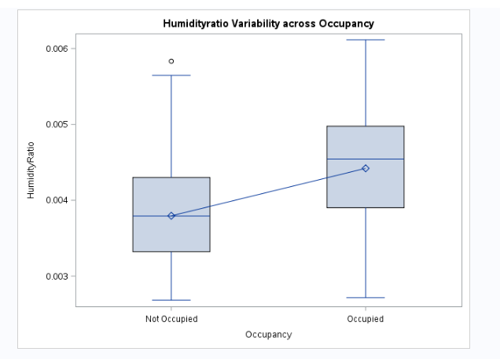
Exploratory Analysis – 2)Association
Visual representation of variance in Predictor variables Light, CO2 and Humidity Ratio
Conclusion
From the results shown in T test and the Box plot plot, we conclude Light, CO2 and humidity Ratio Ratio to be included in the regression model.

Slide 11
Regression Modeling Results – Building the Model
For this analysis, Binary Regression model is used. Binary Regression Model, is used to build a regression model when the response variable is binary such as in our case where response Y = Occupancy
After exploring the data by identifying the best predictor variable X = (Light, CO2 and Humidity Ratio) and finding out the appropriate regression modeling technique. Next step is to build the model.
3. The Proc Logistic function is used to build a regression model in SAS
We use the EVENT= 1 option to model the probability of a room being occupied taking Light, CO2
and Humidity Ratio into consideration.

Slide 12






Regression Modeling Results – Analyzing the Model
What is the relationship between Occupancy and each of its predictor variables?
Occupancy(Y/1)= log[ p / (1-p) ] = -9.1517+0.0264*Light
For every one unit change in Light, the log odds of an occupied room vs not occupied increases by 0.0264
For one unit increase in Light, the odds for the room to be occupied increases by a factor of 1.027 or (1.027-1)*100 = 2.7%
Occupancy(Y/1)= log[ p / (1-p) ] = -4.0138+0.0037*CO2
For every one unit change in CO2, the log odds of an occupied room vs not occupied increases by 0.0037
For one unit increase in CO2, the odds for the room to be occupied increases by a factor of 1.004 or (1.004-1)*100 = 0.4%
Occupancy(Y/1)= log[ p / (1-p) ] = -4.9932+869.6*HR
For every one unit change in HR, the log odds of an occupied room vs not occupied increases by 869.6
For one unit increase in HR, the odds for the room to be occupied increases by a factor of 1000

Slide 13
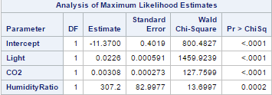

Regression Modeling Results – Analyzing the Model
Which predictor variables have the most influence in determining the occupancy status
of a room compared to the other predictor variables.?
Occupancy(Y/1)= log[ p / (1-p) ] =
-11.3700+0.0226*Light + 0.00308*CO2+307.2*Humidity Ratio
Here the coefficient of light says that holding CO2 and HR at a fixed value, we will see exp(0.0226) = 1.023 i.e. 2.3% increase in the odds of the room being occupied for a 1 lux unit increase in light. Similarly its 0.3% for 1ppm unit CO2 and 9% for 0.0001 unit increase in Humidity Ratio
From the above analysis , we can conclude that Humidity Ratio is the most influential ambient factor in determining the occupancy status of a room since the odds for the room to be occupied increases by a factor greater than 1000 compared to unit increases in Light and CO2.

Slide 14
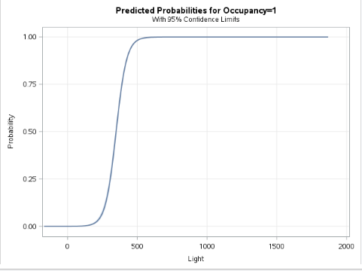
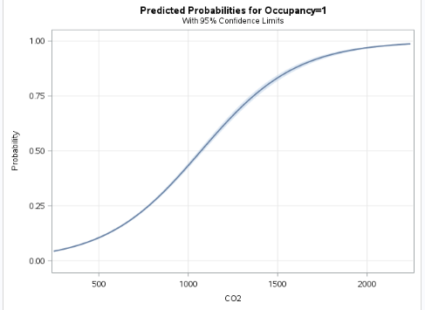
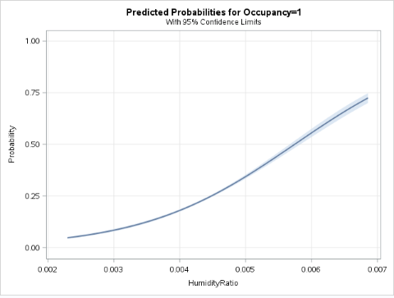
Regression Modeling Results – Analyzing the Model
What are the ideal predictor variable values that can determine the occupancy status?
From the probability graph we can also conclude that the below values of variables will be able to determine that a room has been occupied
Light intensity above 400 lux
CO2 levels above 1200ppm
Humidity Ratio above 0.06 kgwater-vapor/kg-air

Slide 15
Regression Modeling Results – Predicting values
What is the probability of a room being Occupied given a set of predictor variables?
Here, data from the dataset was randomly selected and tested for occupancy status
Occupancy(Y/1)=
log[ p / (1-p) ] = -11.3700+0.0226*Light+0.00308*CO2+307.2*HumidityRatio
log[ p / (1-p) ] = -11.3700+0.0226*(585.2)+0.00308*(749.2)+307.2*(0.004764)
log[ p / (1-p) ]= 5.62
Probability(Occupancy=1) = e^5.62/((e^5.62)+1) = 0.99= 99.64%
High probability shows that the room is occupied which matches Occupancy = 1 in our dataset
log[ p / (1-p) ] = -11.3700+0.0226*(6.5)+0.00308*(433.5)+307.2*(0.004281)
log[ p / (1-p) ]= -8.572
Probability(Occupancy=1) = e^-8.572/((e^-8.572)+1) = 0.00018= 0.018%
Low probability indicates that the room is not occupied which matches Occupancy = 0 in our dataset
This shows that our model prediction is accurate for given set of variable values

Slide 16
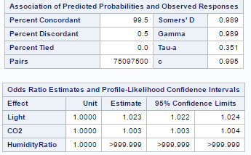
Regression Modeling Results – Model Efficiency
Efficiency of our model
Our model shows a c value of 0.995 (closer to 1) which shows that our model is accurate.
Also the confidence intervals is above 1 for Light, CO2 and Humidity Ratio and thus we can conclude that there is positive association .

Slide 17
Conclusion
Binary Logistic model is effective in detecting the occupancy status of a room.
Out of all the predictors, Light, CO2 and humidity ratio can successfully determine the occupancy status of a room.
Humidity Ratio is the most influential ambient factor in determining the occupancy status of a room compared to Light and CO2.
The chances of a room to be occupied increases with every unit increase in Light, CO2 and Humidity Ratio. Thus they are all positively associated.
The model proved successful in determining the ideal values of ambient parameters for occupancy comfort.
This model was successful in determining the probabilities to detect room occupancy using random data from the dataset.
7. Overall, this model can be used to detect presence of unauthorized personnel in restricted areas using the ambient parameters.

